Slide 1
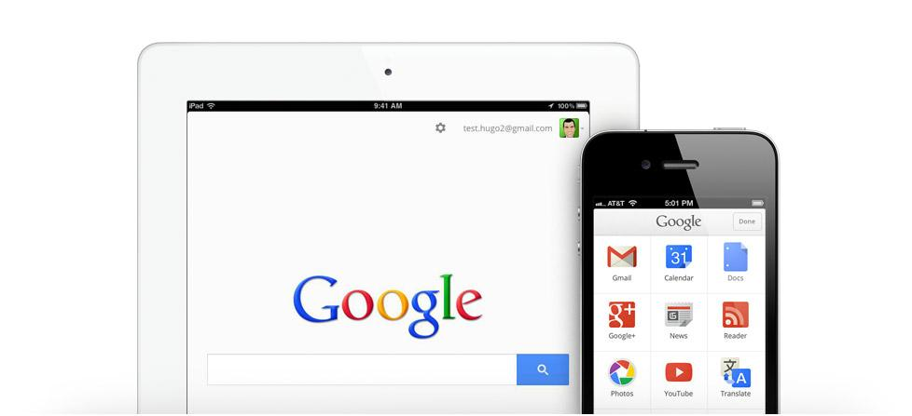
1:1 with iPads:
Google Apps
presented by
Kristine Scharaldi
email: ks@kristinescharaldi.com
web: www.kristinescharaldi.com
twitter: @kscharaldi
about me: http://about.me/kristine.scharaldi

Slide 2
Agenda/Learner Outcomes:
This session will highlight how Google Drive, Docs, Sheets, and other Google Apps operate, and will share some of the limitations of some other apps on the iPad, such as the use of Slides and Forms.
Learn how to navigate, customize, and collaborate with Google apps on the iPad.

Slide 3
Feature Highlight:
“Okay Google” will start a voice seach...
tap microphone icon in address bar and speak question aloud
a response will be a computer-spoken answer as well as search results with links
**provides users an alternative to typing and reading text and makes relevant content more accessible
Google Search

Slide 4
Feature Highlights:
save and access different types of files (created in Google as well as other applications) on and offline
store pictures and videos in Google Drive to save storage space on the iPad and to access them on other devices (tap + in top right corner to upload from Camera Roll and capture directly from camera)
Google Drive

Slide 5
Feature Highlights:
create, save and access documents across devices
users can share documents with others for collaboration and commenting
**allows users to move towards a paperless classroom
Google Docs

Slide 6
Feature Highlights:
create, save and access spreadsheets across devices
users can share spreadsheets with others for collaboration and commenting
**allows users to organize and share data for various purposes
Google Sheets

Slide 7
Feature Highlights:
web browser that includes voice search and the ability to find a word(s) on web page
share bookmarks across devices when signed in
Google Chrome

Slide 8
Feature Highlights:
type, speak, handwrite, and copy/paste word(s) to be translated
dozens of languages are supported
can see and hear the translated text
**provides users alternatives to engaging with the text and makes translating text more accessible
Google Translate

Slide 9
Feature Highlights:
millions of videos to support learning and instruction
can create and subscribe to channels
can curate and organize videos into playlists that can be public or private
ability to upload videos and movies created on the iPad
YouTube

Slide 10
Feature Highlights:
search and view locations all over the world
voice-guided GPS directions
explore by zooming in and out
can view in standard and satellite with 3D
use street view (orange icon of person) to explore 360 degrees panaramic images
Google
Maps
Google
Earth

Slide 11
More Google iOS Apps:
Google +
Google Hangouts
Gmail

Slide 12
Google Apps with Limitations:
Google Slides
(Presentations)
Google Forms

Slide 13
Thank you for attending:
1:1 with iPads: Google Apps
presented by Kristine Scharaldi
email: ks@kristinescharaldi.com
web: www.kristinescharaldi.com
twitter: @kscharaldi
about me: http://about.me/kristine.scharaldi
Online Conference Evaluation:
https:/sites.google.com/site/gappssummitnj/evaluation

