Slide 1
Creative Ideas for Using
Google Calendar in the Classroom
presented by Kristine Scharaldi
email: ks@kristinescharaldi.com
web: www.kristinescharaldi.com
twitter: @kscharaldi
about me: http://about.me/kristine.scharaldi

Slide 2
Agenda/Learner Outcomes:
Discover new ways of using Google Calendar beyond organizing your time. Come and explore how Google Calendar can be used as an instructional and learning tool across grade levels and subject areas. In this session we will share lesson ideas and other creative ways educators are incorporating Google Calendar in the learning process.

Slide 3
Lesson Example:
Telling time & Google Calendar
Elementary/Primary. Students review how to read and calculate time traditionally using digital and analog clocks and learn the agenda format as another way to understand time. This format allows students to see “blocks” of time and challenges them to start thinking and visualizing differently about time and segments of time.
https://docs.google.com/document/d/1YkchsM-P2UidevSdqB5mPHuXDcnRrUBP-t5krxKWX00/preview

Slide 4
Lesson Example:
History of Life on Earth
Middle/Early Secondary School. Using Google Calendar and a research-based table listing the history of living organisms scaled down to a one year duration, students will collaborate to create a Google calendar showing the history of life on Earth that includes links to background information of the events and summarizing that time period.
https://docs.google.com/document/d/18vnv4eu5X8EWXpdUMgtYGKDdjxlodVVgL2-9VDRGQ68/preview

Slide 5
Lesson Example:
Great Moments in Art
High/Secondary School. Great Moments in Art is an event calendar that uses Google Calendar to create a calendar of artist birthdays and other moments in art history and link those events to a geographic location. Students may visit any museum website and select an artist or art event to research.
https://docs.google.com/document/d/1nza4Xg9703EPCBYBtcxf3mT4TQQYxaP4q0fj_77wGCs/preview

Slide 6
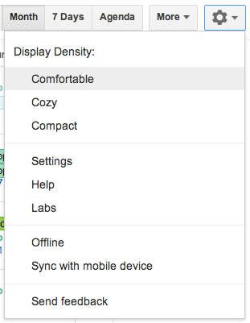
Calendar Labs

Slide 7
Calendar Labs

Slide 8
Calendar Labs

Slide 9
Calendar Labs

Slide 10
Calendar Labs

Slide 11
https://docs.google.com/document/d/1rPx1yrX6qkhyVMopMhzoCzi51DDSM7oKg4ghYc80EOk/edit
http://davidleeedtech.wordpress.com/2013/03/17/google-calendar-features-for-teachers-tips-and-tricks
For more help with Google Calendar….

Slide 12
Thank you for attending:
Creative Ideas for Using
Google Calendar in the Classroom
presented by Kristine Scharaldi
email: ks@kristinescharaldi.com
web: www.kristinescharaldi.com
twitter: @kscharaldi
about me: http://about.me/kristine.scharaldi
Online Conference Evaluation:
https:/sites.google.com/site/gappssummitnj/evaluation

