Slide 1
Google Apps for Ed
ELA Classroom Edition
Rapid Fire Session Presented by:
Google Certified Educator
Natalie O’Neil nvazquez@wmrhsd.org @TeachNV http://bit.ly/GAFEELA

Slide 2
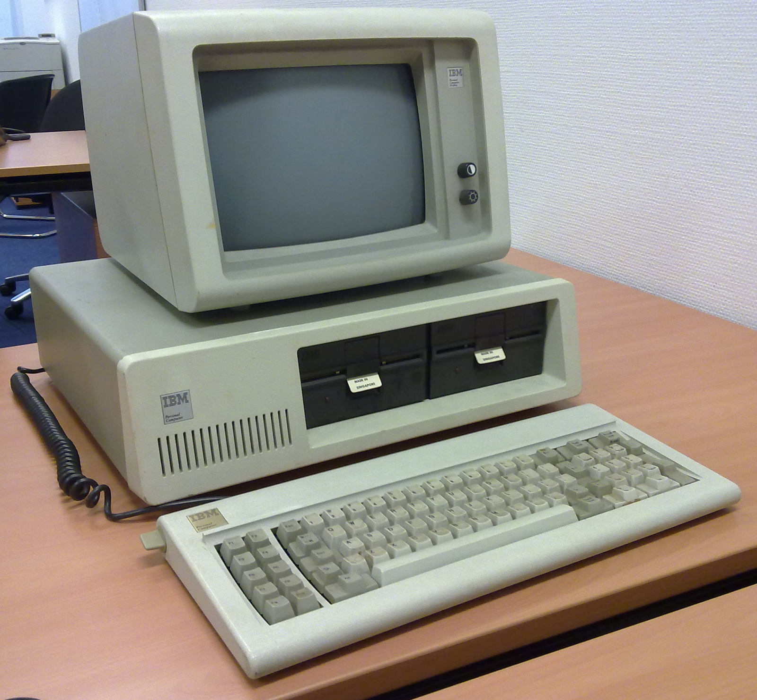
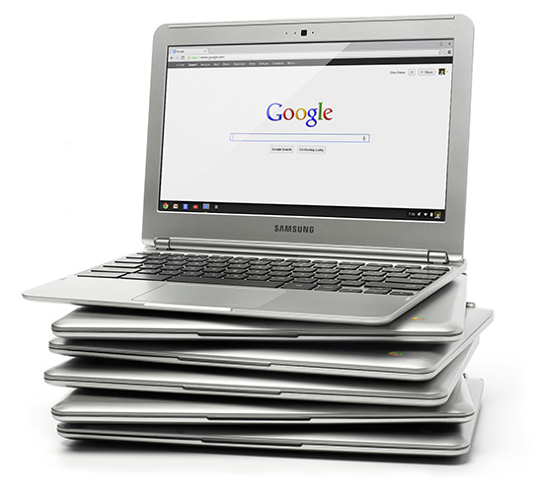
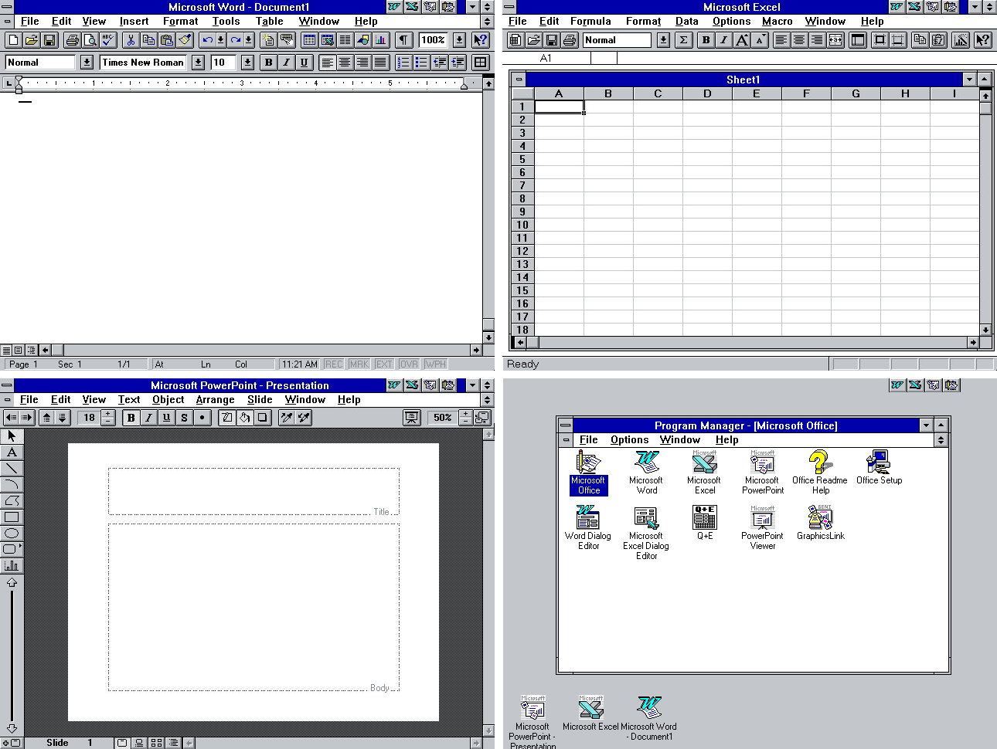
Goodbye Microsoft, Hello Google

Slide 3
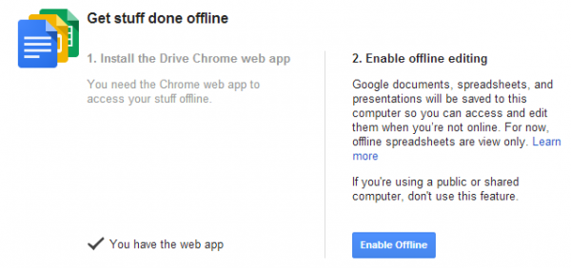
Drive
Notes:
Multi-Device Accessible, Cloud Storage & Offline Capabilities

Slide 4
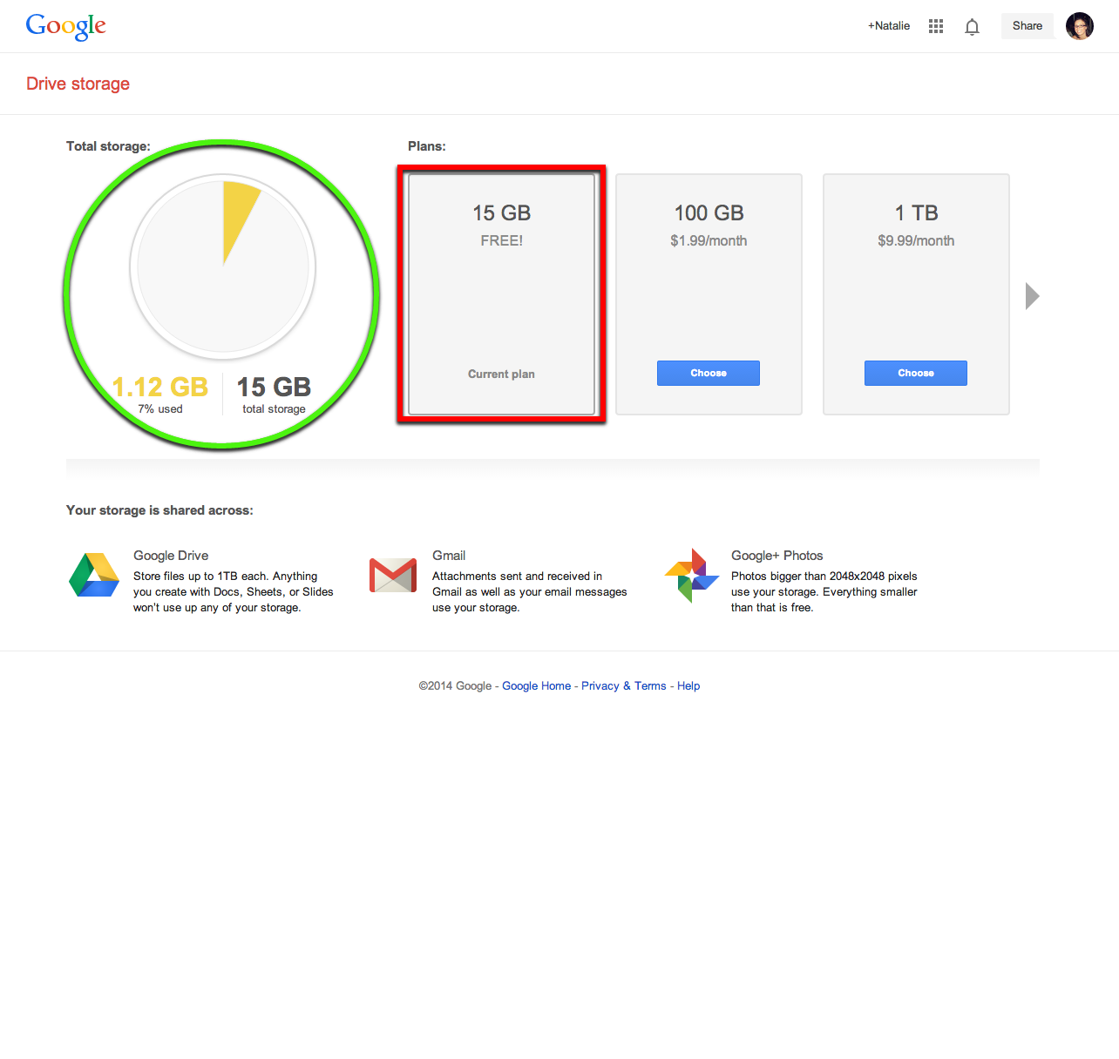
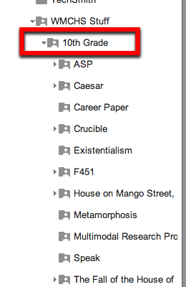
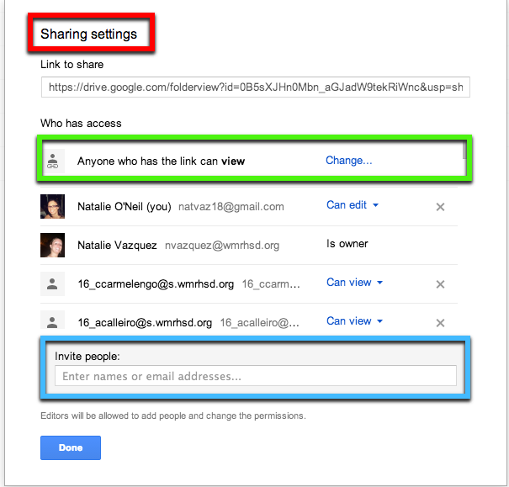
Store, Organize, Share
Notes:
Google URL Shortener: http://goo.gl/

Slide 5
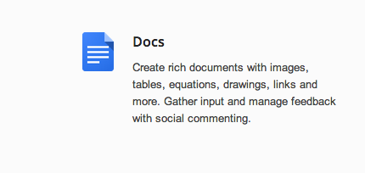
Google Docs

Slide 6
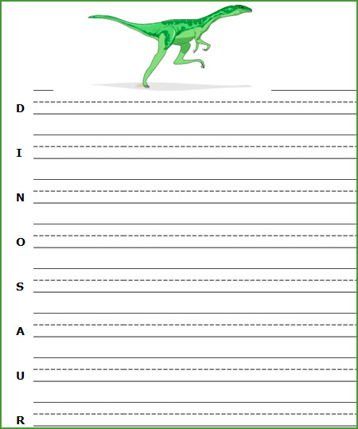
Collaborate on Docs
Lesson Plans
Worksheets
Journals
Essays
Notes:
Readability in Chrome Web Store
Mike Marotta’s Assistive Tech Resource Page

Slide 7
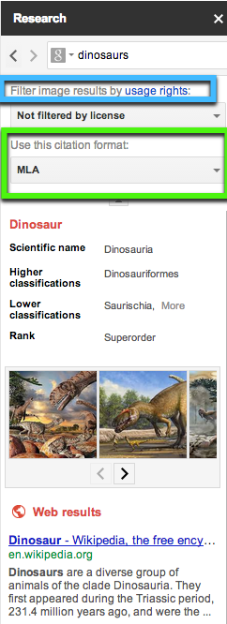
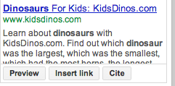
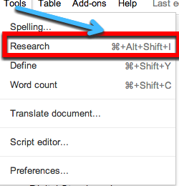
Research With Docs
Notes:
Research Guide

Slide 8
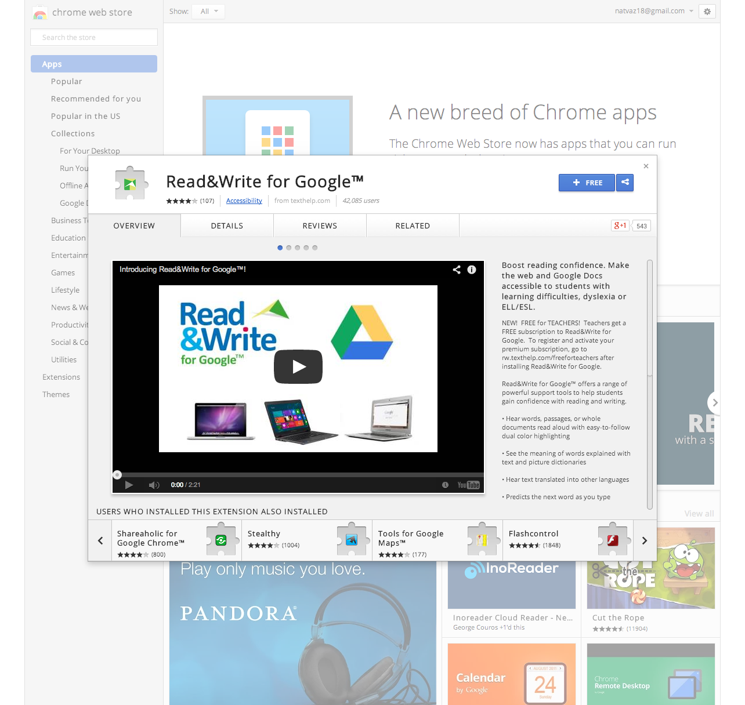
Read & Write Extension
Notes:
Tutorial Here, https://chrome.google.com/webstore/detail/texthelp-study-skills/fjgimeiehjeaammngbkmpmjikfpknmpf?hl=en
http://youtu.be/FFdHAoNZgiw

Slide 9
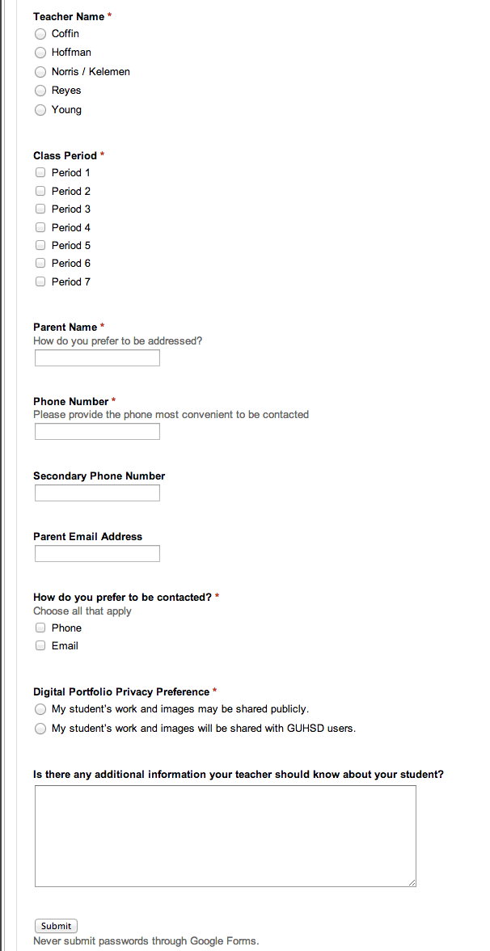
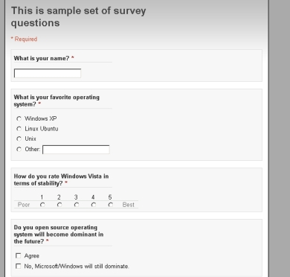
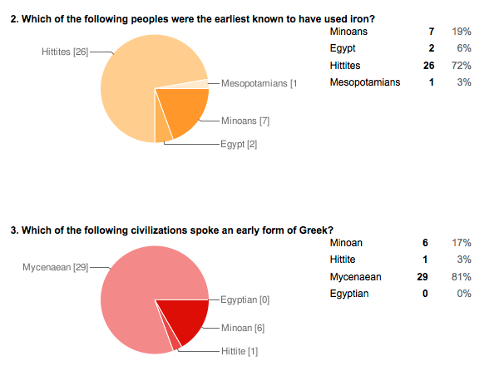
Google Forms
Surveys & Polls
Quizzes & Assessments
Contact Info Gathering
Sample Quiz Ideas
Notes:
Forms Guide and Creating a Quiz with Grading component using Flubaroo can be found by clicking the link.

Slide 10
Google Presentation Slides
For Teachers
Content Delivery
Multimedia Aids
Jeopardy Reviews
For Students
Group Presentations
Vocabulary Flashcards
Digital Storyboards

Slide 11
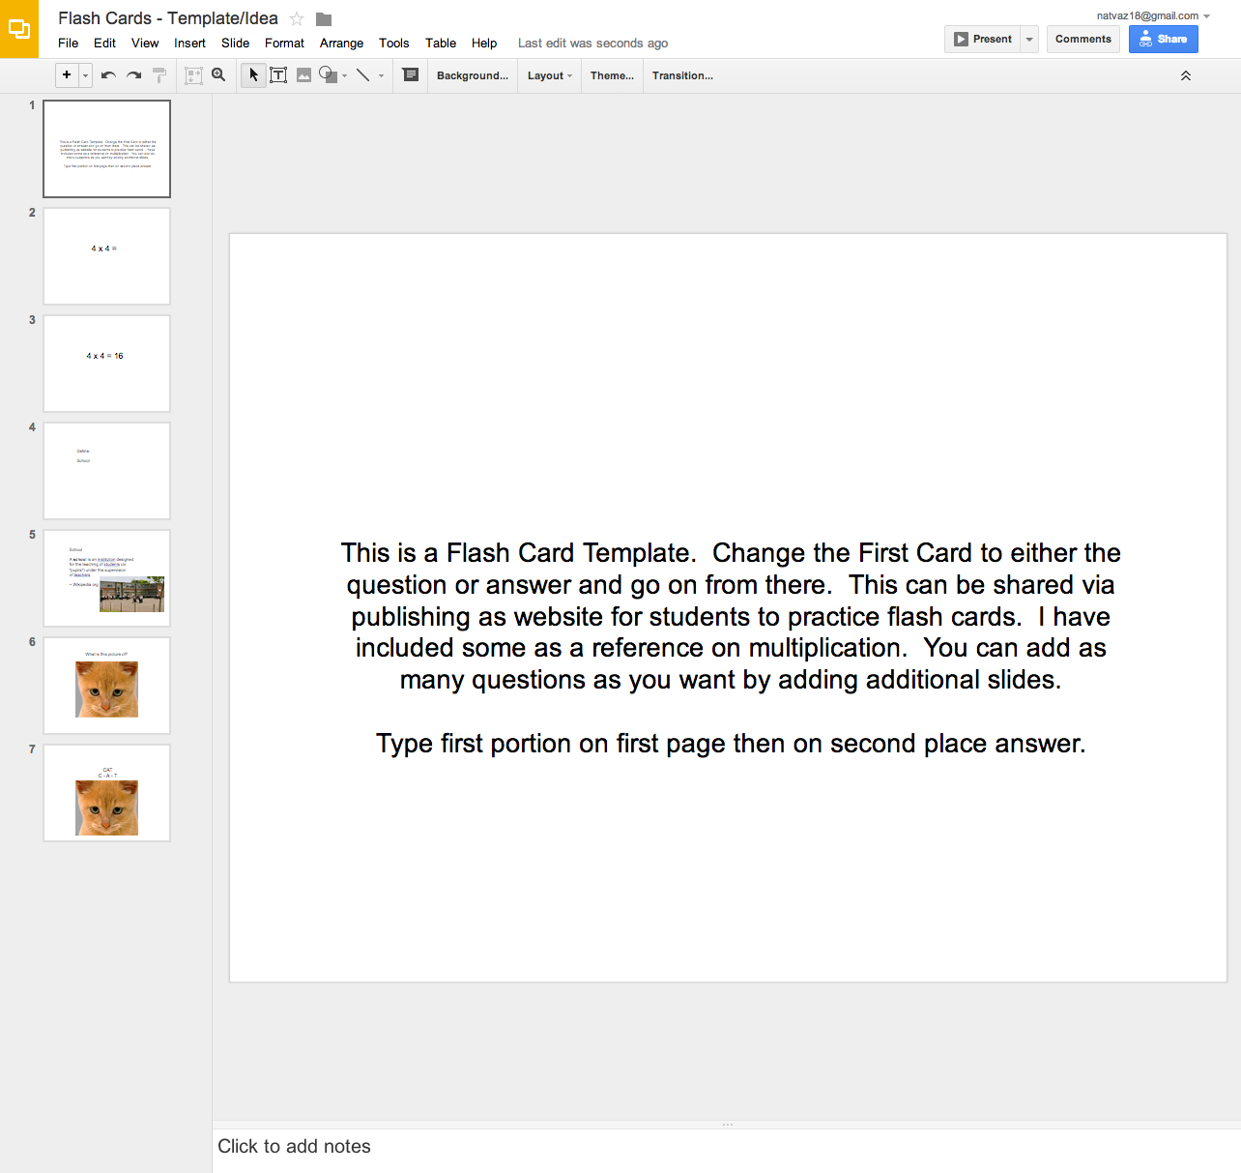
Slides Template Ideas
Notes:
Jeopardy Template & Flash Card Template here.

Slide 12
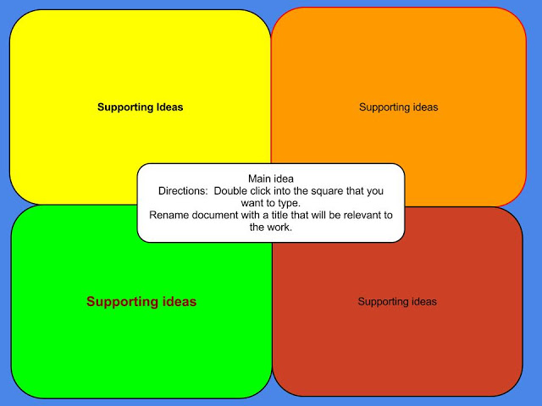
Google Drawing
Mind Maps
Graphic Organizers

Slide 13
Google Apps for Ed
ELA Classroom Edition
Session Evaluation: https:/sites.google.com/site/gappssummitnj/evaluation
Natalie O’Neil nvazquez@wmrhsd.org @TeachNV http://bit.ly/GAFEELA

