Slide 1
Your Projects and Initiatives
with support from Google Apps
John Altieri
Email: jpaltieri@gmail.com
Twitter: @jpaltieri
@2altieri

Slide 2
Choose the right app, if an app at all.
You don’t go to the hardware store because you need a drill;
you go because you need to put a hole in something.
-B. Ovenell-Carter @braddo
Are we acting on the past (b/c we have the tool),
or on purpose (need)?

Slide 3
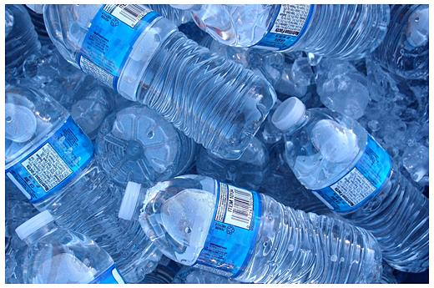
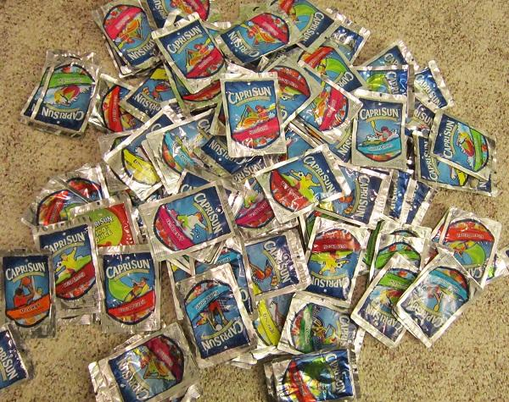
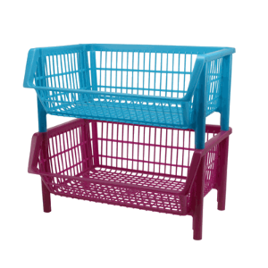
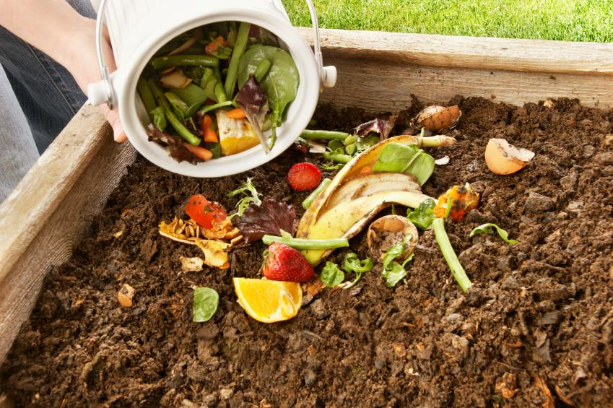
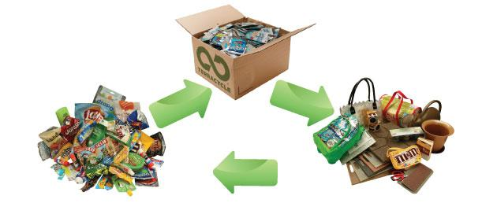
A need led to possibilities...

Slide 4
Each possibility has an audience...
By reaching out to the community, we find the people who will participate and help support the initiative.

Slide 5
Audience
These are some pretty important buttons...

Slide 6
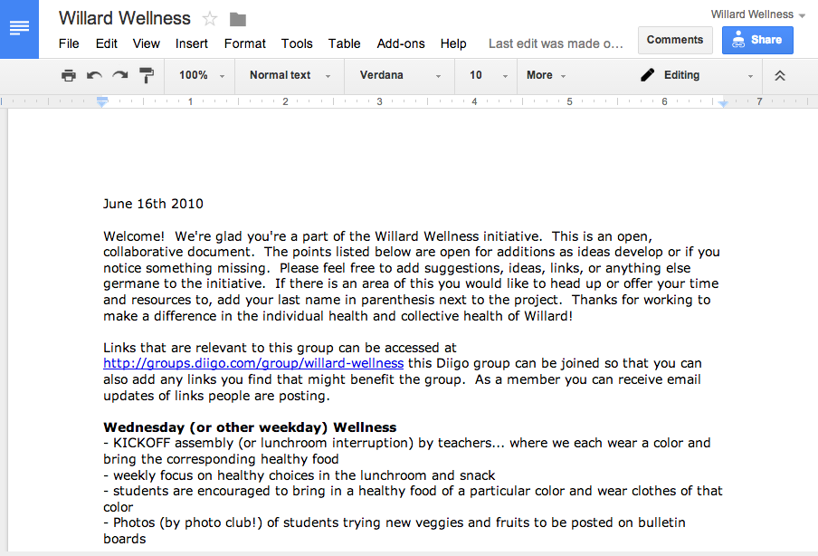
Documents: Shared Meeting Notes

Slide 7
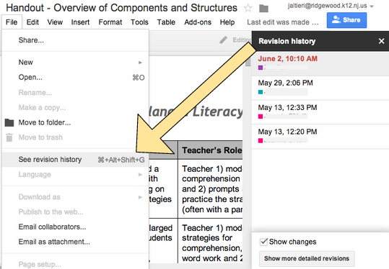
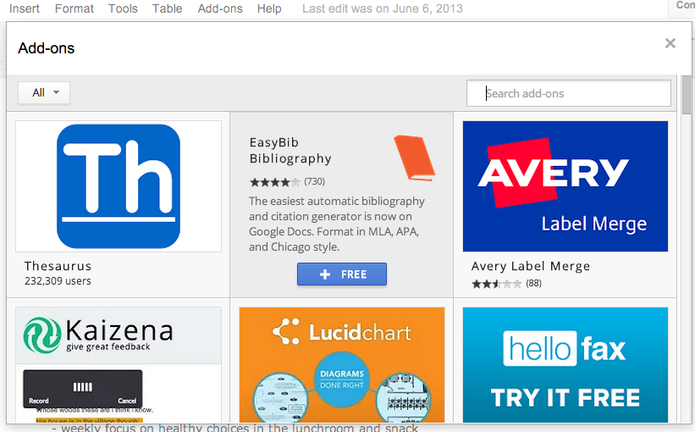
Inside Documents
Many options, from reviewing revisions to “Add-ons”.

Slide 8
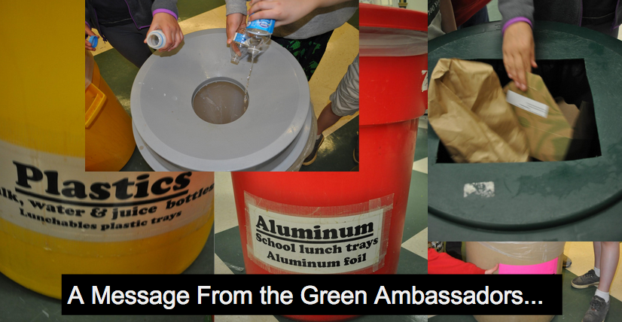
Slides: Get the word out!
Slideshows are useful for sharing in classrooms and could even stand in for assemblies.
...but they don’t always replace that face-to-face or community time.

Slide 9
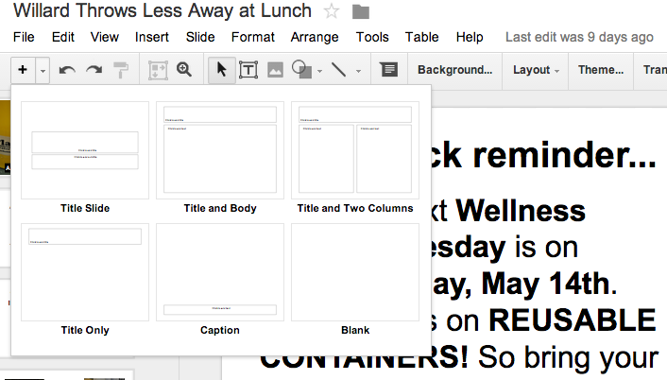
Inside Slides
Quickly add a slide and choose the layout.
Google Slides works similarly to Powerpoint. They are fairly compatible with .pptx files.

Slide 10
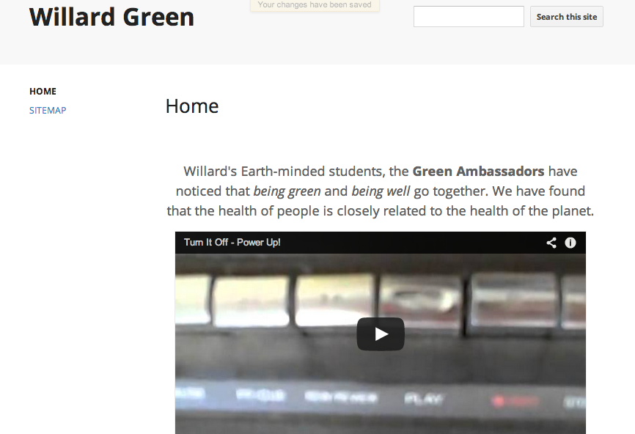
Using a Google Site for general info...

Slide 11
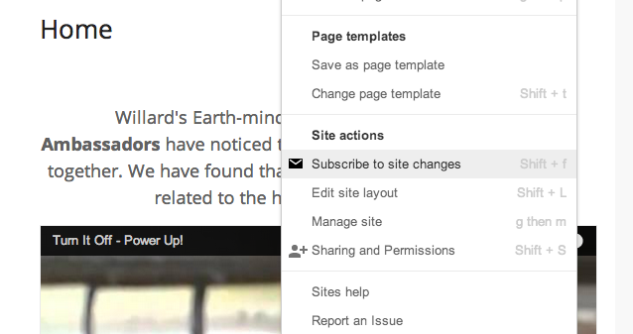
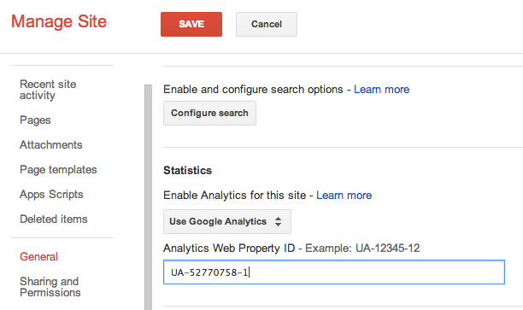
Inside Sites
Subscribe to get email updates on site changes.
Analytics to follow visitors

Slide 12
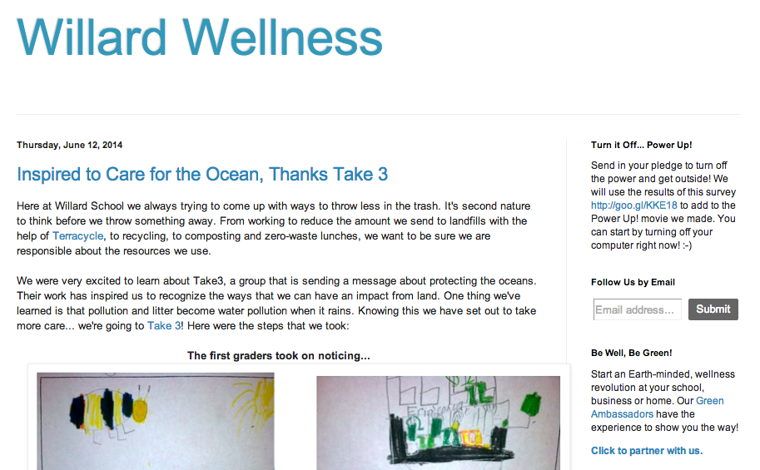
Blogger: Tell the story.
Using a blog we are able to put together updates about our latest project or experience. This gives us a link to share those moments through email, on Twitter, etc.
http://willardwellness.blogspot.com/

Slide 13
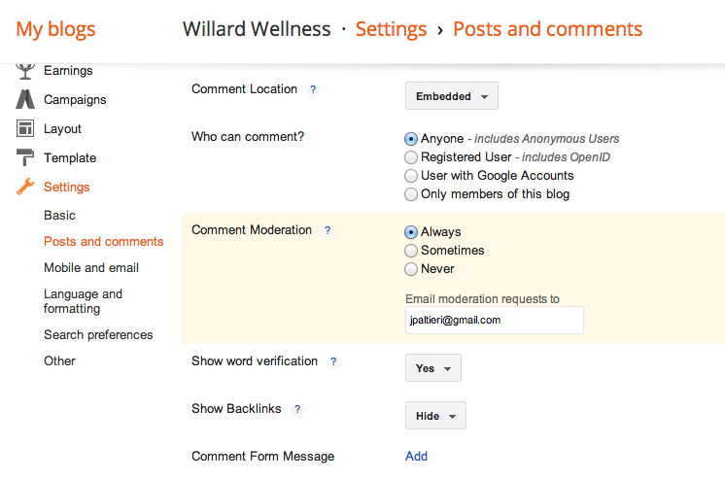
Inside Blogger
Moderate comments and get email updates whenever a comment is made.

Slide 14
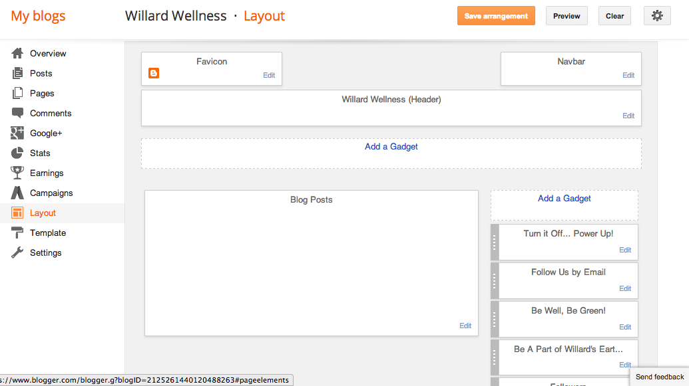
Inside Blogger
For some projects a blog can do the job of a website. Work with the layout to get the features you need.

Slide 15
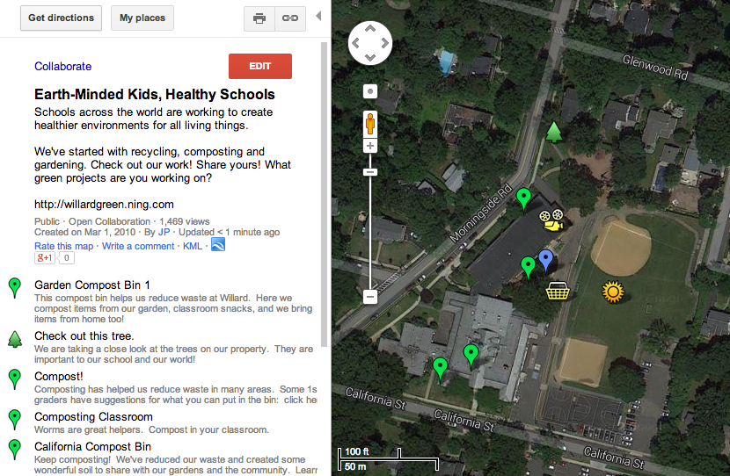
Google Maps: a link to places
A Google My Map can show where and how.

Slide 16
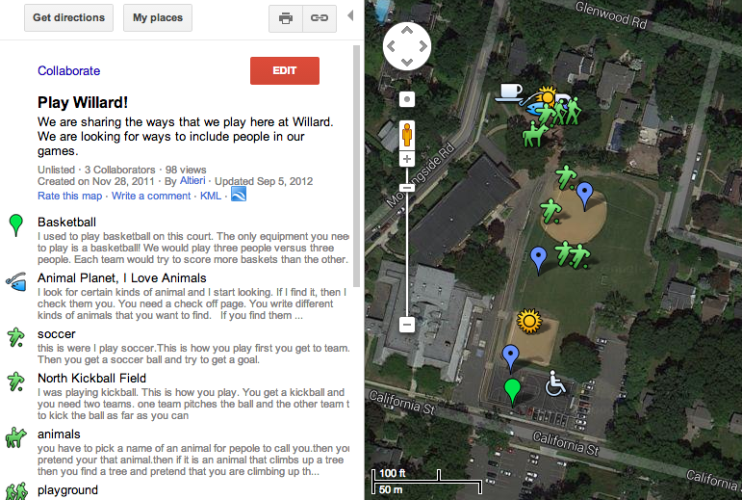
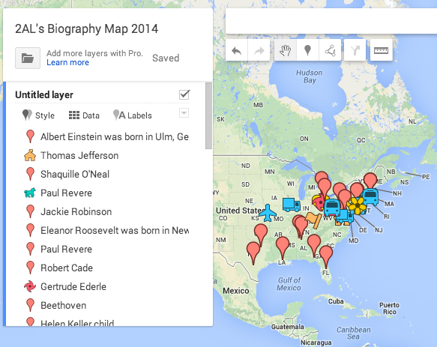
Inside Maps
Collaborate
Examples of maps created through student collaboration.

Slide 17
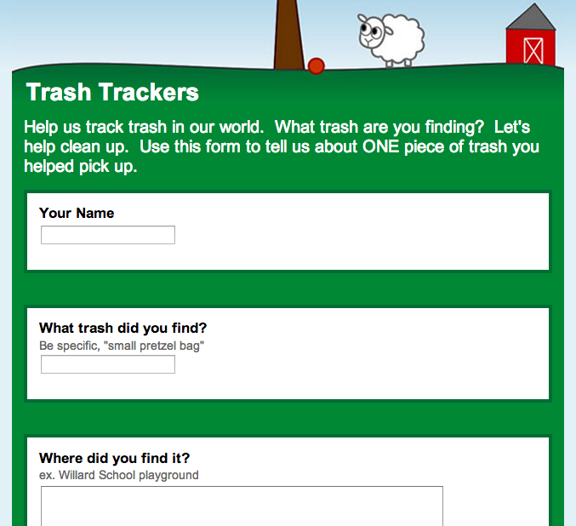
Forms: feedback and/or action
Linked to a spreadsheet.

Slide 18
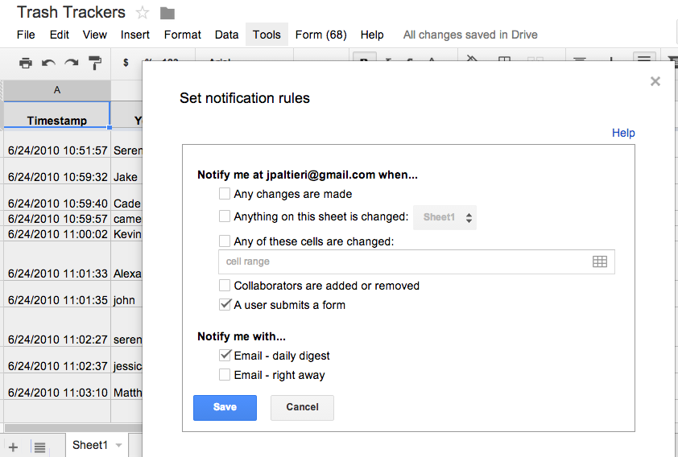
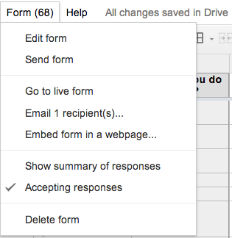
Inside Forms
Get email updates every time a form is submitted.
Get back to the form from the sheet.

Slide 19
YouTube: teaching and updating

Slide 20
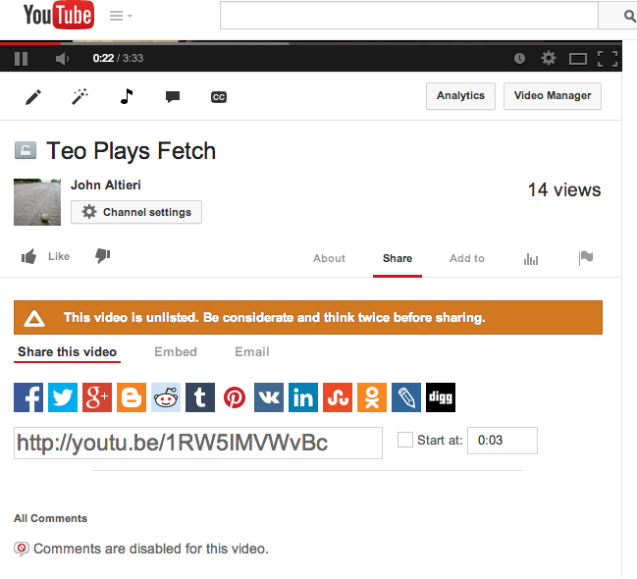
Inside YouTube
Share videos by getting the url.
Also, you can click “Info and Settings” and then “Advanced Settings” to turn off commenting and manage other elements.

Slide 21
Special Mention...
Picasa Web
(or Drive for photos)
Google Calendar
Google Hangouts

Slide 22
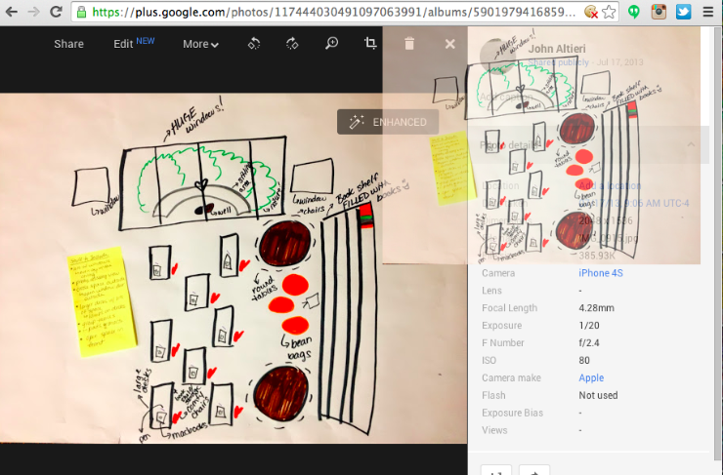
Inside Picasa Web
Add photos by dragging and dropping them into other applications.

Slide 23
Common Core Standards That Are Met Through the Use of Various Technologies:
Direct reference to technology
Fluency:
CCSS.ELA-LITERACY.RF.2.4
Read with sufficient accuracy and fluency to support comprehension.
CCSS.ELA-LITERACY.SL.11-12.5
Make strategic use of digital media (e.g., textual, graphical, audio, visual, and interactive elements) in presentations to enhance understanding of findings, reasoning, and evidence and to add interest.
No direct reference to technology
Click for a link of some CCCS that can relate to technology.

Slide 24
John Altieri
Willard Elementary, Ridgewood, NJ
Email: jpaltieri@gmail.com
Twitter: @jpaltieri
@2altieri
Google Summit evaluation form:
https://sites.google.com/site/gappssummitnj/evaluation

