Slide 1
Google Scripts
Joe Donahue
personal email: jdonahue805@gmail.com
school email: jdonahue@collegeschooldistrict.org
G+: jdonahue805
twitter: @jdonahue805
Google Education Trainer
Google Education Trainer
Google Education Trainer

Slide 2
What is/are/am Google Scripts?
Scripts are mini-programs
They run within a Google Doc
Some automate repetitive tasks
They save you time and keep you organized
Google Education Trainer
Google Education Trainer
Google Education Trainer

Slide 3
Today we’ll look at:
Doctopus
Flubaroo
Goobric
Autocrat
More if time allows

Slide 4
Where’s my Script Gallery?

Slide 5
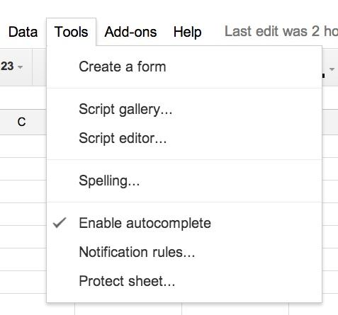
Where’s my Script Gallery?
Here it is!
Gone……..

Slide 6
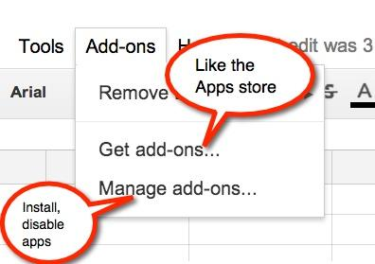
Add-ons

Slide 7
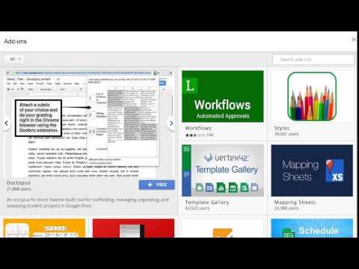
Add-ons

Slide 8
Doctopus
An easy way to:
Share templates with a class
Organize student files on your Drive
Grade and give personalized feedback

Slide 9
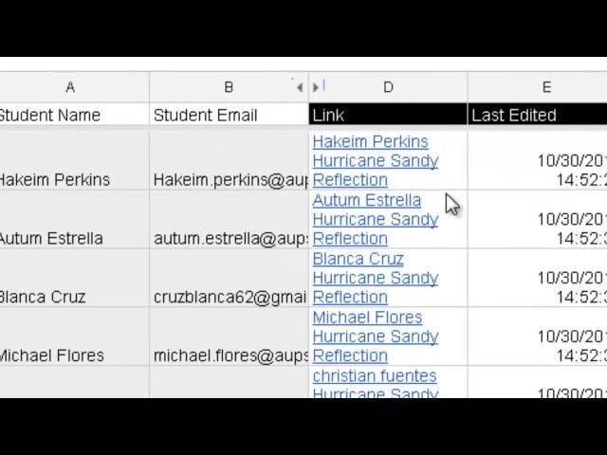
Doctopus
Yeah, but how does it do that?

Slide 10
Doctopus
Let’s give it a try!
Open a new spreadsheet in Drive
Click on add-ons>get add-ons
Search for Doctopus
Click the blue “Free” button and install
Follow the setup instructions on the left
Take a look around, but wait for the next steps

Slide 11
Doctopus
Let’s give it a try!
Create/name a roster
Select a sharing type (probably individual)
Select the template to use
Use this one if you want
Choose file name format
Review, then Run

Slide 12
Doctopus
What you’ll get:

Slide 13
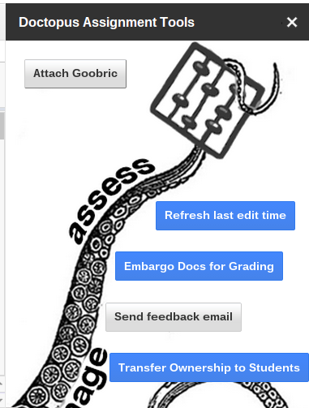
Doctopus
What you can do:

Slide 14
Flubaroo
Self-grading Tests

Slide 15
Flubaroo
Let’s give it a try:
Create a quiz
or use this one if you want (make a copy)
Install Flubaroo
Add-ons > get add-ons > search Flubaroo
Open form responses
Run Flubaroo
Add-ons > Flubaroo > Grade Assignment

Slide 16
Flubaroo
Follow the steps and instructions
What you’ll get:

Slide 17
Goobric
Only works in Chrome Web Browser
Not a script, an extension
Install from the “get add-ons” link
Let’s take a look

Slide 18
Other scripts to review
Autocrat
Use forms and spreadsheets to merge, create, and share documents
gClassFolders
Create folders for each student, for a teacher, or a whole school

Slide 19
Thank You
Please remember to complete the evaluation

