Slide 1
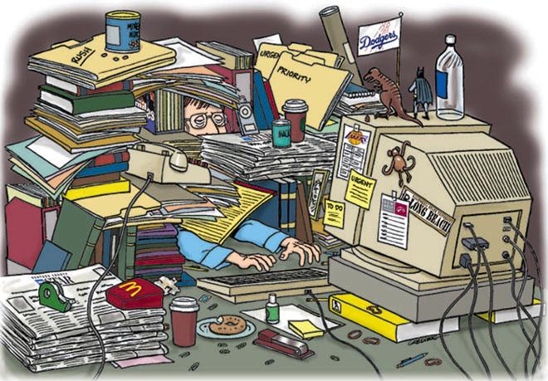
Organize your Drive
Sarah Marr

Slide 2
Google Drive
Notes:
(1 min)
Google Drive is such a powerful tool, as noted in this short video. However, it’s important to stay organized throughout the year so that your Drive doesn’t become unmanageable/disorganized.

Slide 3
Learner Outcomes
To organize your Drive to make folders/student work more accessible.
Notes:
(2 min)
Today, you will learn ways to easily organize your Drive to set yourself up for a successful, organized, time efficient school year.

Slide 4
Agenda
Create
Color
Share
Synching
Reflect/evaluation
Notes:
(1 min)

Slide 5
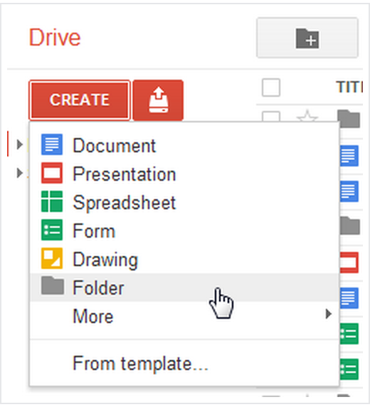
Create Folders
Notes:
(1 min)
Click on the red “Create” button to create a new: Folder, document, presentation, spreadsheet, form, or drawing.

Slide 6
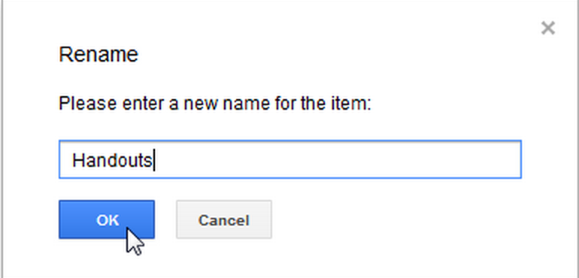
Name folders
Notes:
(5 min)
Folder suggestions: Return to school, Handouts, Do Nows, Assessments, Lesson Plans, Professional Development, From the Office, Exemplary student work, Class folders

Slide 7
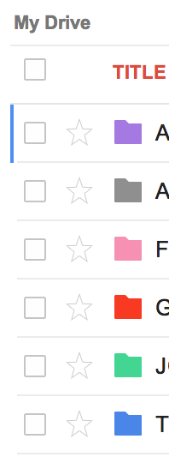
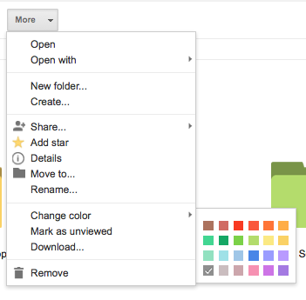
Color Code your folders
Notes:
(5 min)
You can color code your files to help stay organized. There are a few ways you can do this:
1)Click on your desired folder. At the top of your page options will pop up. Click on “more” then drop down to the “change color” option. Check the color that you want to assign to this folder.
2)From your navigation menu, or title of the folder, a grey downward arrow will appear when you hover over the folder. Click on the arrow and the same options menu will pop up. Click on “change color” to select the desired color.
Take the next 4 minutes to color code your folders.

Slide 8
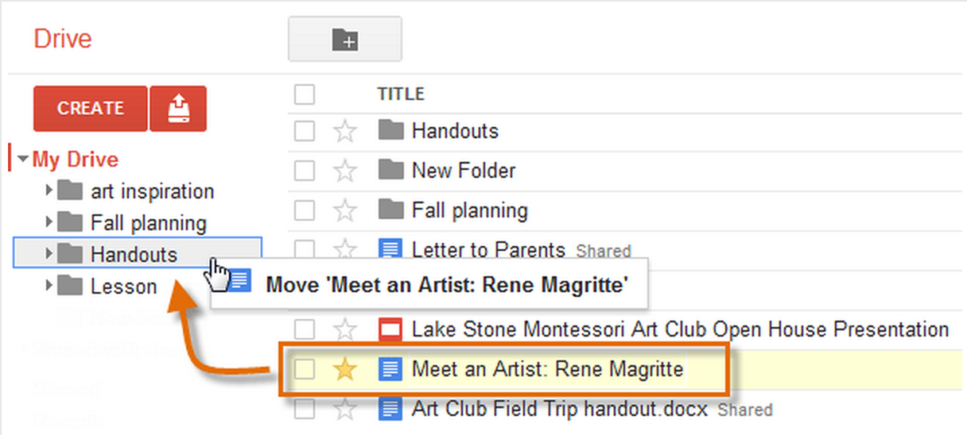
Organize documents
Notes:
(7 min)
You can move documents into folders two ways:
1)Click and drag the document into the desired folder on your page. Check the boxes to select multiple documents.
2) Check the box of the desired document you wish to move. Click the folder icon at the top of the page. Then click on the desired folder you wish to move the doc to.
Take the next 5 minutes to organize some existing files into folders. If you don’t have any existing files, then start creating a “Get to know you” survey from google forms that students can complete on their first week back. Place this file under a “New school year” folder.

Slide 9
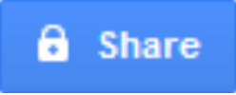
Sharing Items
Notes:
(1 min)
There are two ways you can share items:
Once you are in a document
1) click on the big blue share button.
2) click in the person+icon.
You then type in the email addresses in the window that pops up. You can add groups, individual emails.
Doctopus- add on that creates copies for each student/groups of students when sharing so that your kids don't have to. Also, has a function where a graded rubric can be inserted at the bottom of a students submitted assignment.

Slide 10
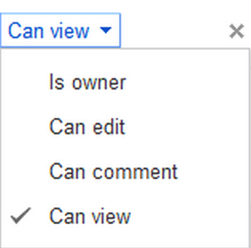
Levels of Permission
Notes:
(3 min)
When you share a document through google docs, you decide how much access that person has to your document.
Once you list the email addresses, you can give people access to the document. There are three different options:
1) Can edit-- the person can make changes to your document with this option. This is great for group work & for when teachers are looking to make revisions to student work.
2) Can comment--the person cannot edit the document, but can make comments. The comments are not visible when printing. This is useful for peer-editing or if the teacher wants to leave feedback for students.
3) Can view--this allows the person to only view the document. This is great for readable material (syllabus, sample work, etc.), or for documents that serve as templates; students can then create a copy of the document and edit it on their own.

Slide 11
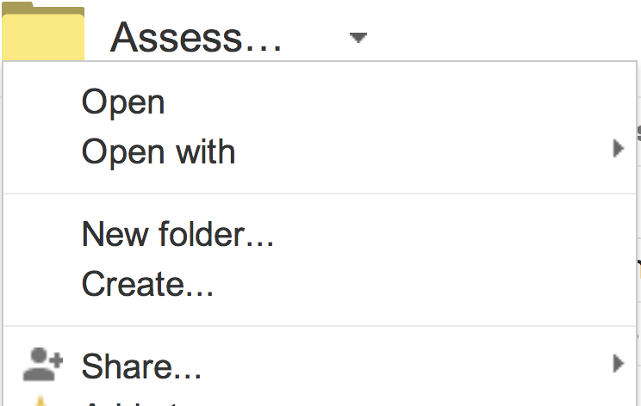
Sharing Items: Folders
Notes:
(5 min)
If you have many people (like several classes of students) to share a document with. Sharing a folder, such as a “handout folder” is a time saver.
Once you are in the folder, you have two options.
1)Click the person + icon on the right.
2)Go into the drop down menu to the right of the folder title. Then click on the “share” icon.
Add email addresses similar to how you did for a single document.
This is great for sharing handouts. Make a handout folder and drag-drop all handouts into this folder that is shared with all of your students. The set up is a one time thing that you do at the beginning of the school year.

Slide 12
Windshield wiper- formative assessment
More on Google Groups:
http://goo.gl/P7uXsm
Notes:
(1 min)
1-CLEAR = I get it! I thoroughly understand the concept.
2-BUGGY = I understand it for the most part, but a few things are still unclear.
3-MUDDY = I don’t get it at all.

Slide 13
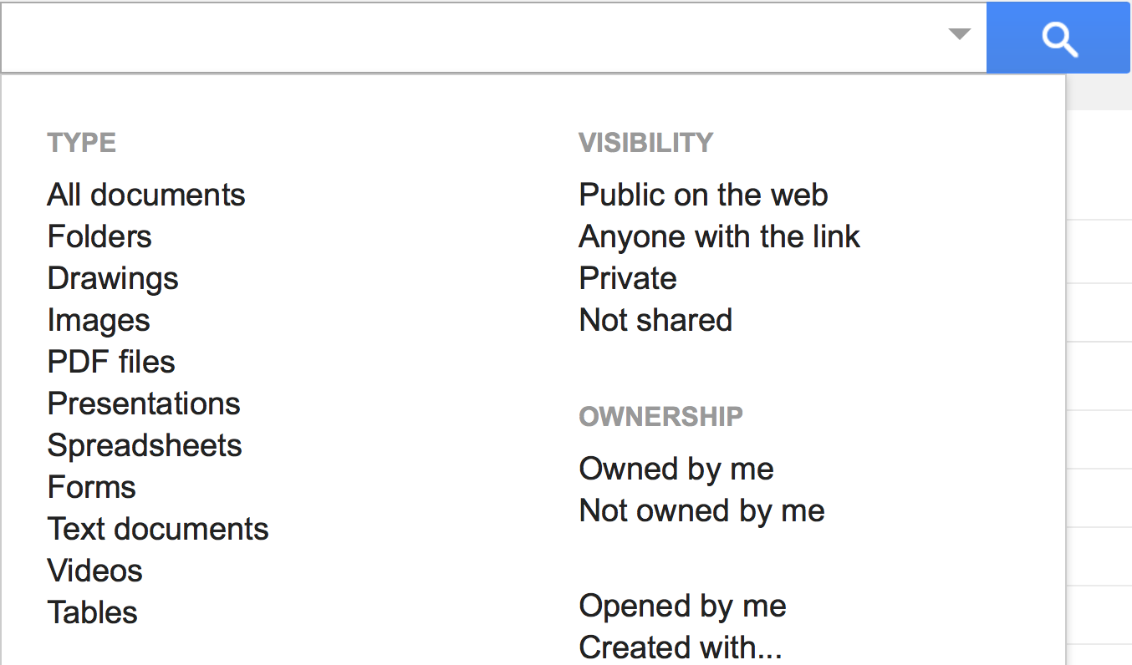
Search
Notes:
(5 min)
All items are saved & listed alphabetically in your Drive. This is why it’s essential that you have a naming/labeling system for your documents (ex: Year_Class_Unit_title).
By typing a title or key word of the title into the search box at the top of your screen, Google will pull up all matching items. If you click on the downward arrow to the right of the search bar, there is added criteria that you can use to help with your search.
Take 4 minutes to conduct searches & become familiar with this feature.

Slide 14
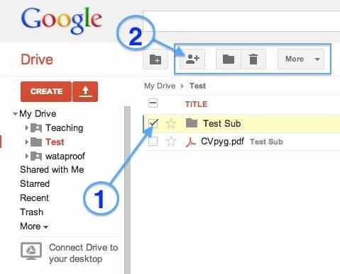
Student submission: Folders
Notes:
(1 min)
Another way to use folders is to have each students create a “turn-in” folder for you. To submit an assignment, the student simply moves the document/assignment into this folder.
Once the student creates the folder, names it something that makes sense to you (Year-period-student name-Turn In), they should share it with you and give you “Can edit” or “Can comment” permission.
When you click on “Items shared with me” you will see each students folder where you can access their work. If you have a lot of students, make a class turn-in folder, then drag & drop each students folder into the appropriate class period.
THis is a one-time process that you need to do at the beginning of the year.
https://docs.google.com/document/d/1fzwQSQbMKtBYJawRzjs0NrLN0QQnTPV-rlzc5_N4lEU/edit#heading=h.now6otnzk26y

Slide 15
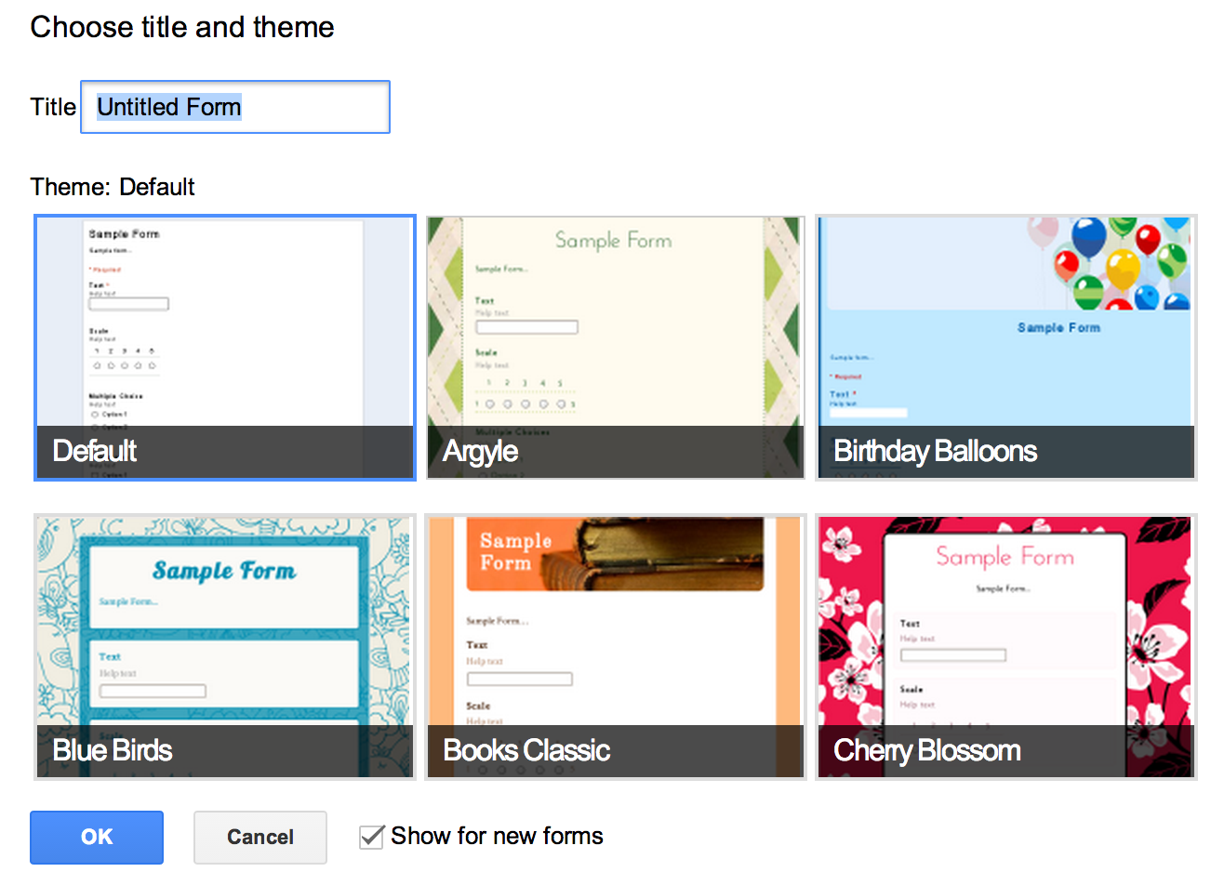
Student submission: Forms
Notes:
3 min
My preference for student submissions, especially if you have a lot of students, is for them to submit assignments under “forms.”
We will create a form for your first assignment of the school year (get to know me letter to my teacher, recipe of me, summer reading project, etc.).
Click create--form. A dialogue box will pop up. Enter your desired title (it can be modified later). Select a theme.

Slide 16
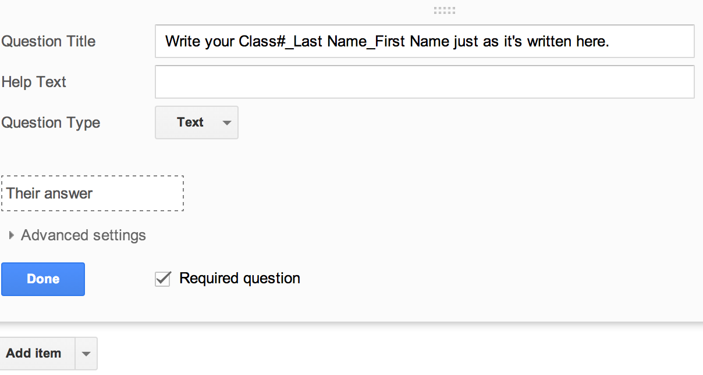
Student submission: Forms
Notes:
2 min
Question title should always be the students name exactly how you want them to submit it.
Click required question so that students must include the necessary information.
To finish creating the form, click done. If you want to add another item, click add item.

Slide 17
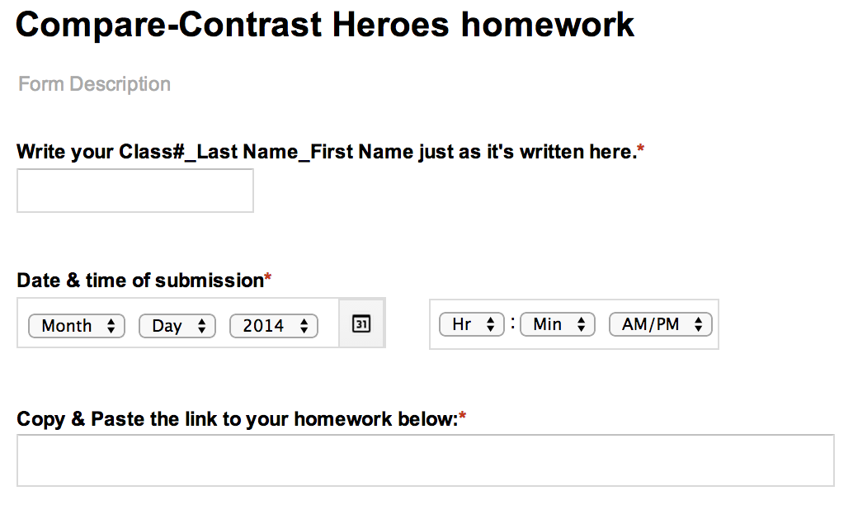
Student submission: Forms
Notes:
(1 min)
I recommend at least two questions/items:
1)student name from a “text” question type.
2)URL link to the assignment from the question type “paragraph text”

Slide 18
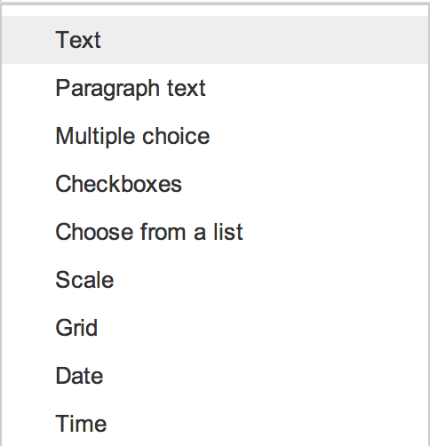
Student submission: Forms
Notes:
(1 min)
There are many types of items that you can add to your form.
Here are examples of the question types.
There are options beyond question types, such as inserting a video or image.

Slide 19
Student submission: Forms
Notes:
(1 min)
When you look in the folder where you saved this homework, you will notice that a response spreadsheet is automatically created that records all responses. When you open this spreadsheet, you will be able to see each students submission & the link to their work. Time efficient way to have one document contain all student work. Say goodbye to lugging home stacks of work to grade :)

Slide 20
Uploading & Converting files
Notes:
(5 min)
Uploading files:
Google drive can, also, store non-Google files, but they will appear in preview mode. Click the red upload button, find the file you want to upload, then click open. Your file will appear in Drive until you place it in the desired folder.
Convert files:
If you want to convert those uploaded files to google, drag & drop your files into Google Drive. If you have non-microsoft items, such as Keynote, make sure that you save a copy of the file in microsoft format or it won’t convert properly & your work will be lost.
Right click on the file (mac= control click). It will give you the option to open the file in a viewer or as the recommended Google App.
Some formatting may change in conversion, so make sure you have files backed up just in case.

Slide 21
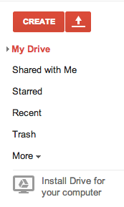
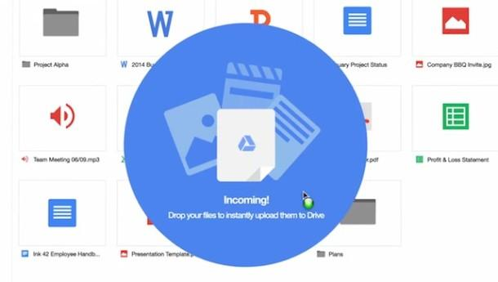
Sync devices
Notes:
(5 min)
You are able to work in Drive from your computer desktop, smartphone, or tablet. As long as you’re connected to the internet, then all work will sync with the Drive in the cloud. If youre working offline and on your desktop Drive, for example, once you get internet access your devices will sync.
Comp: At the bottom of your navigation menu, you will see a grey option “install drive for your computer.” This will install Drive on your computer and walk your through steps to link it to your google account.
Phone/tablet: go to Google Play Store or iTunes, search, and download the Google Drive app. Once downloaded it will walk you through setup to link to your google account.

Slide 22
Reflection
Notes:
(3 min)
Ah-ha moments?
Questions?
Comments?

Slide 23
Evaluation
https://sites.google.com/site/
gappssummitnj/evaluation
Tweet about this session:
#EduscapeSummit
Notes:
(2 min)

