Slide 1
Lesser Known Google Apps
Eduscape Learning
Stacy Baker
7/15/14
Notes:
*

Slide 2
Agenda
How to locate the other apps
Translate
News
Scholar
Trends
Blogger
Drawing
Notes:
*

Slide 3
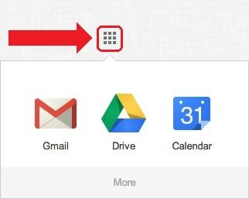
Where are the other apps?
Click on the app launcher in the top right corner
Click “More” and then “Even More”
Notes:
*

Slide 4
Translate
Write letters to parents in their target language or use speaking tool during parent conferences
Translate web pages
Foreign language students can check their work and improve/rate sentences*
Save important sentences in Phrasebook
Notes:
*

Slide 5
News
Compare and contrast current events from numerous sources
Find primary documents from historical events over the past 200 years
Create your own customized newspaper
Notes:
*

Slide 6
Scholar
Peer-reviewed articles, books, court opinions, professional society papers, etc.
Abstracts are free, but many complete articles are not
Great for high school
Notes:
*

Slide 7
Trends
Analyze the change in frequency of certain search terms
Breaks down the frequency by countries, regions, cities, and languages
Make predictions about future trends
Notes:
2 minutes. Go to Google Trends and type in a keyword to show the audience how this works.
*

Slide 8
Blogger
Create a class blog
Have students create their own blog
The benefits of blogging
reflect on learning
peer-review and feedback
keep a project journal
connect with the greater world
Notes:
*

Slide 9
Drawing
Create a mindmap or flowchart
Create visuals for a vocabulary word or concept
Drawings can be embedded into any Google Document
Notes:
*

Slide 10
Thank you from Eduscape Learning
Please take the evaluation at the end of your final workshop!
http://sites.google.com/site/gappssummitnj/evaluation
phone 800-781-7976
email instructor stacy@myeduscape.com
Notes:
*

