Slide 1
Become a
Google Calendar
Pro

Slide 2
This presentation will show you how to:
create a calendar
create events
color code calendars and/or events, add flair (Labs)
share and/or publish a calendar
import a Google Calendar, import an iCal Calendar
plan lessons with Google Calendar
suggestions for further personal development

Slide 3
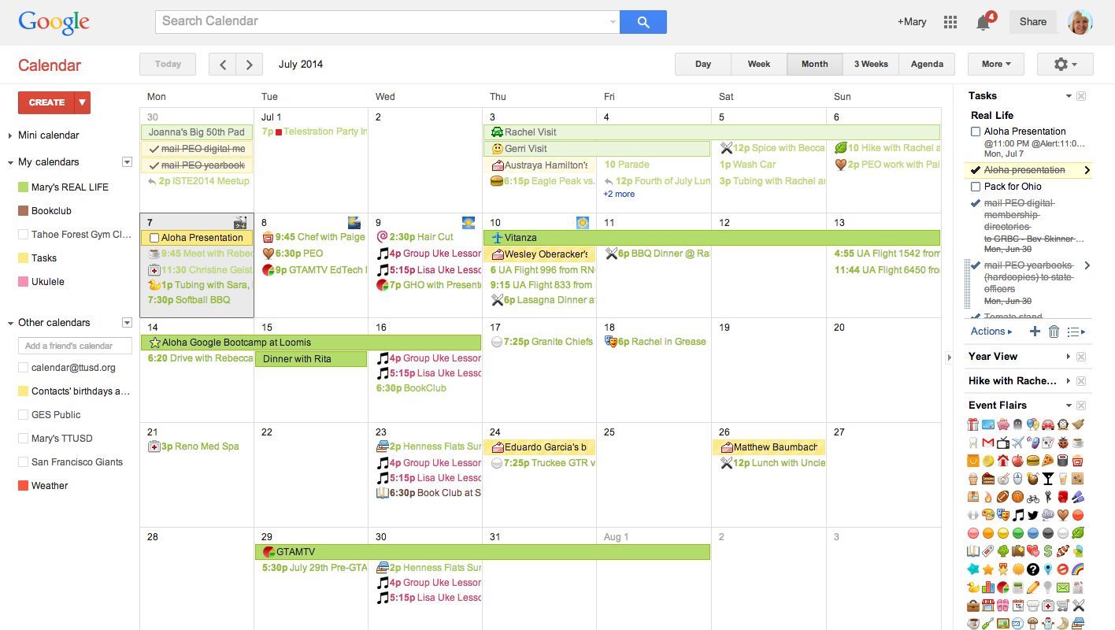
Let’s start with exploring Google Calendar’s interface.

Slide 4
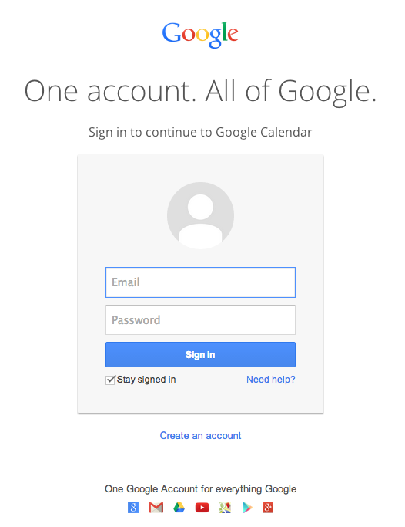
CREATE A CALENDAR
Create a new calendar
Go to Google Calendar
www.google.com/calendar

Slide 5
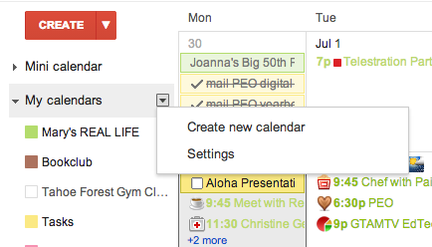
CREATE A CALENDAR
Select the menu drop down next to "My Calendars"
Create New Calendar

Slide 6
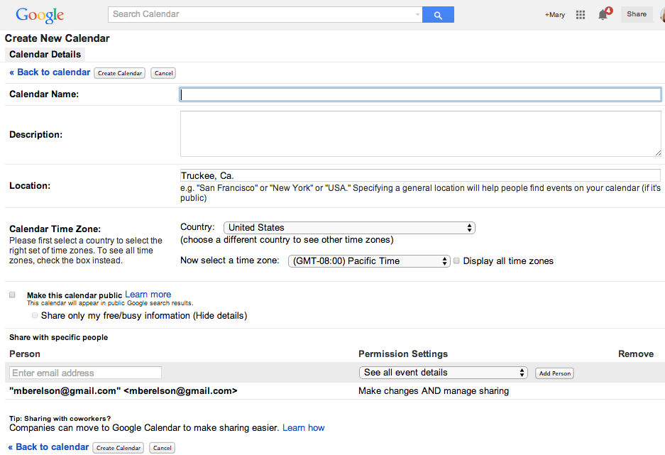
Share?
CREATE A CALENDAR
Give it a name.
Provide a description.
Create Calendar.

Slide 7
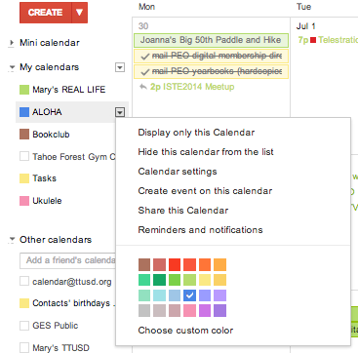
CREATE A CALENDAR
Set your preferences
Color code your calendar
Share your calendar
Set reminder preferences

Slide 8
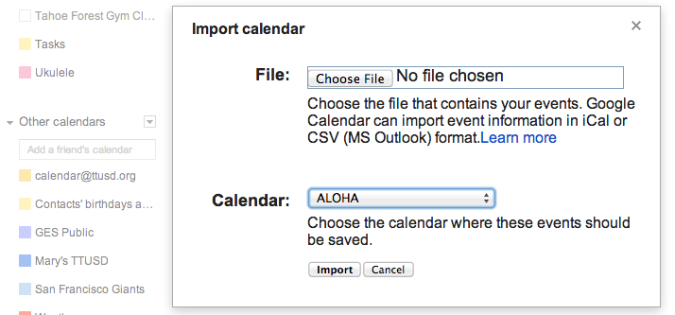
IMPORT OTHER CALENDARS
Import events from iCalendar or CSV files
To import events from iCalendar or CSV files, just follow these steps:
Click the down-arrow next to Other calendars
Select Import calendar
Click Choose file and find the file that contains your events, then click Open.
Select the Google Calendar where you'd like to import events, then click Import.
Please note that recurring events may not be recognized
when importing events from CSV files.
In this case, individual items will be created
for recurring events that fall between the dates you've selected.

Slide 9
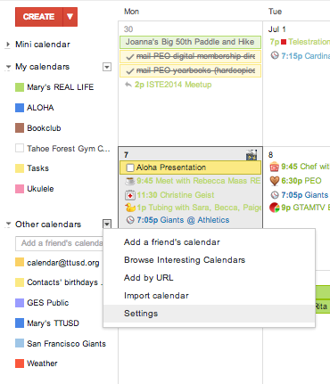
SUBSCRIBE TO CALENDARS
Add a friend's calendar
To add a friend's calendar, just follow these steps:
Click the down-arrow next to My calendars
Select Add a friend's calendar from the menu
Enter the appropriate email address in the field provided, then click the Add button
If your friend has opted to share his or her calendar publicly, it will then appear under 'Other Calendars' in the left column. If not, you'll see a message requesting access to your friend's calendar. Feel free to add a note to the request, then click Send Request.

Slide 10
SUBSCRIBE TO CALENDARS
Add interesting calendars from Google Calendar
Looking to fill your calendar with interesting information and events? Google Calendar offers a selection of calendars covering popular holidays, sports team schedules, and more. To access a directory of these public calendars, click the down-arrow next to Other calendars and select Browse Interesting Calendars from the menu.
When browsing, click Preview to view events on the calendar before adding it to your list. Click Subscribe to subscribe to the calendar -- it will be added to the Other Calendars section of your calendar list. For calendars that you're already subscribed to, you'll see the option to Unsubscribe.

Slide 11
SUBSCRIBE TO CALENDARS
Subscribe to public calendars using the calendar address
To add a calendar using its address, follow these steps:
Click the down-arrow next to Other calendars.
Select Add by URL from the menu.
Find the address of the Google Calendar in iCalendar format, or if you have the iCalendar address of a calendar from a different application (for example, Apple's iCal), you can use this as well.
Enter the address in the field provided.
Click Add calendar. The calendar will appear in the Other calendars section of the calendar list to the left.
Note: It may take up to 8 hours for changes in ICS feeds to reflect in your Google Calendar.

Slide 12
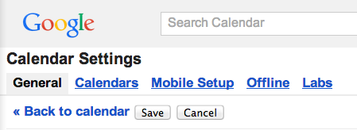
SUBSCRIBE TO CALENDARS
Weather forecasts in your calendar
Once the Weather feature is enabled in your Google Calendar, you'll be able to view the four-day forecast, including the expected highs and lows for each day.
How to enable the Weather feature
To view weather forecasts in Google Calendar, simply follow these steps:
Click the gear icon at the top of any Google Calendar page.
Click Settings
Select the General tab
In the 'Location' section, enter your desired location information (e.g., 'Los Altos, CA' or '94024')
In the 'Show weather based on my location' section, select either °F or °C
Click Save
Click on this icon anywhere on the internet to subscribe to the calendar.

Slide 13
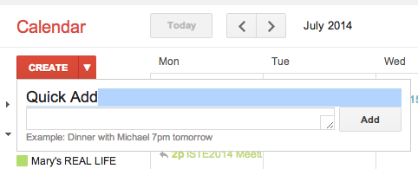
CREATE AN EVENT
Quick Add
Click on the arrow next to "Create" to type in an event
EASIEST

Slide 14
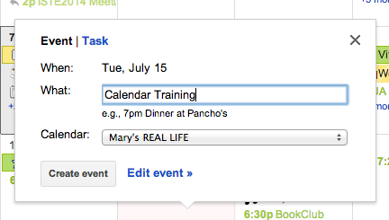
CREATE AN EVENT
Time and Date Add
Click anywhere on
the calendar to add
an event at that time
MORE SPECIFIC

Slide 15
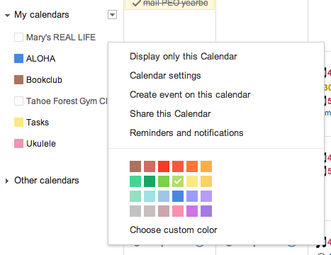
CREATE AN EVENT
Arrow to the right of the calendar name - “create an event on this calendar”
ANOTHER WAY

Slide 16
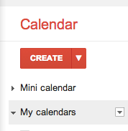
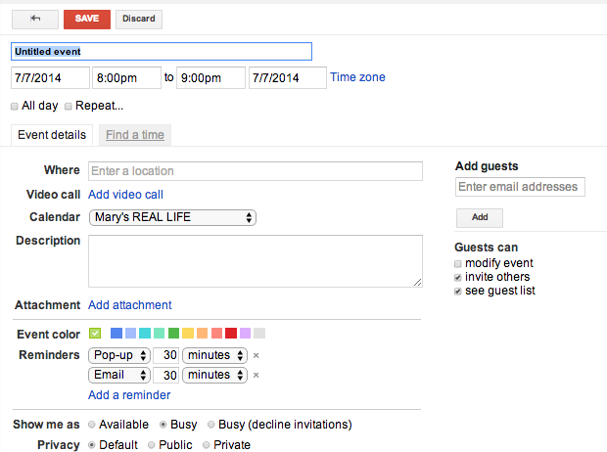
CREATE AN EVENT
Red Create Button
Click on Create
Add title, place, invitees and repeat options
MOST DETAILED

Slide 17
ADDING EVENTS FROM GMAIL
If a date or time is underlined in a message, click the underlined text to add the event to you calendar and preview your schedule.
Update the title, date, or time if needed, and click Add to Calendar.
Once added to your calendar you can click the event title to see the event in Google Calendar.
This feature is only available in English (US)
Events created this way include a link back to the original email.

Slide 18
COLOR CODE AN EVENT
Color code events within a single
calendar to differentiate various tasks.
Before:
After:

Slide 19
MANAGE NOTIFICATIONS

Slide 20
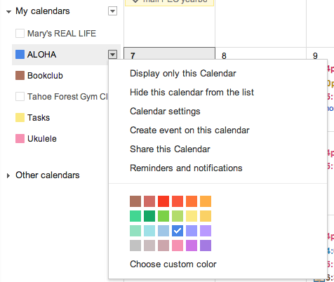
SHARE and COLLABORATE
Go to the individual
calendar tab
Select Share this Calendar

Slide 21
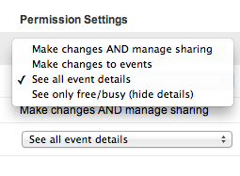
SHARE and COLLABORATE
Two kinds of sharing
Public--Anyone can see
almost everything
Private--Per email address
Select the permission settings

Slide 22
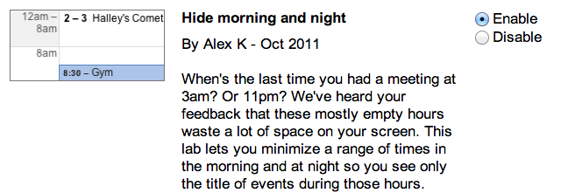
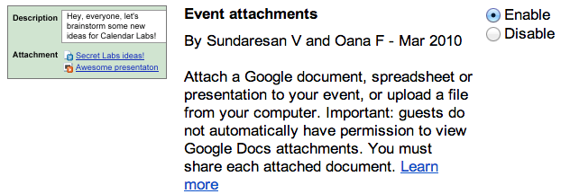
CALENDAR LABS
Labs must be enabled by your domain administration.
Remove your sleeping hours.
Excellent for lesson planning and going paperless.

Slide 23
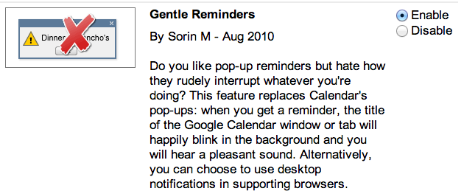
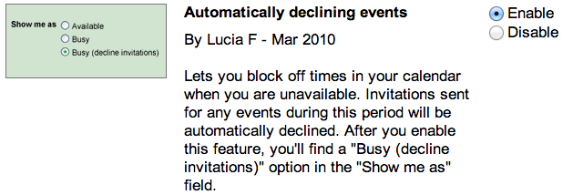
CALENDAR LABS

Slide 24
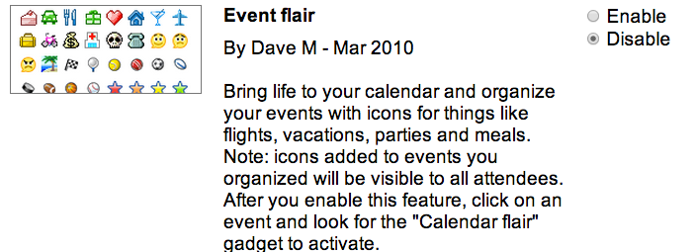
MORE CALENDAR LABS
http://goo.gl/7wpp4R
Third party flairs
with many more options.

Slide 25
MORE CALENDAR LABS
Labs are experimental and can become unstable, stop working, or disappear at any time.

Slide 26
PUBLISH A CALENDAR
For Google Sites:
Go to your Google Site & enter edit mode.
Select Insert Calendar and choose the calendar you want to include on the site.
*Color coded calendars & events do not maintain formatting.

Slide 27
PUBLISH A CALENDAR
For other sites:
Go to your GC and click on individual calendar tab
Select Calendar settings
Copy HTML code and paste into your site's html editor

Slide 28
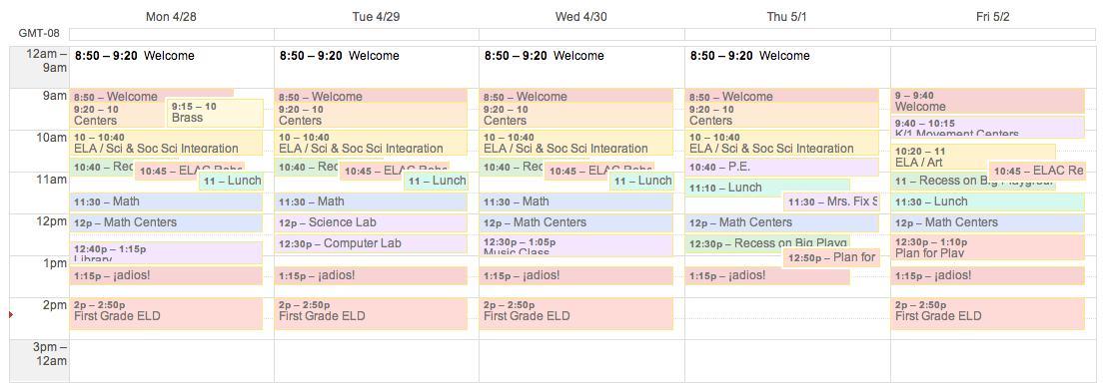
LESSON PLANS
week view

Slide 29
LESSON PLANS
one week of the three week view

Slide 30
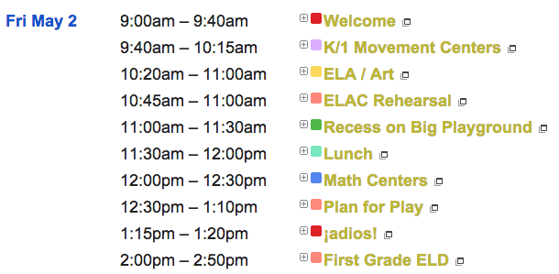
LESSON PLANS
agenda view

Slide 31
TIPS AND TRICKS
Use calendar layers Overlay coworkers calendars on your own calendar to see everyone's available time slots. | Create a team calendar Create a shared calendar to track your team's vacation and travel dates.
Create tasks in your calendar Create tasks directly in your Calendar. | Define default notification reminders Use notification reminders to never miss another event.
Reschedule events with SmartRescheduler Use the Smart Rescheduler lab to quickly reschedule a room and time that works for all guests.

Slide 32
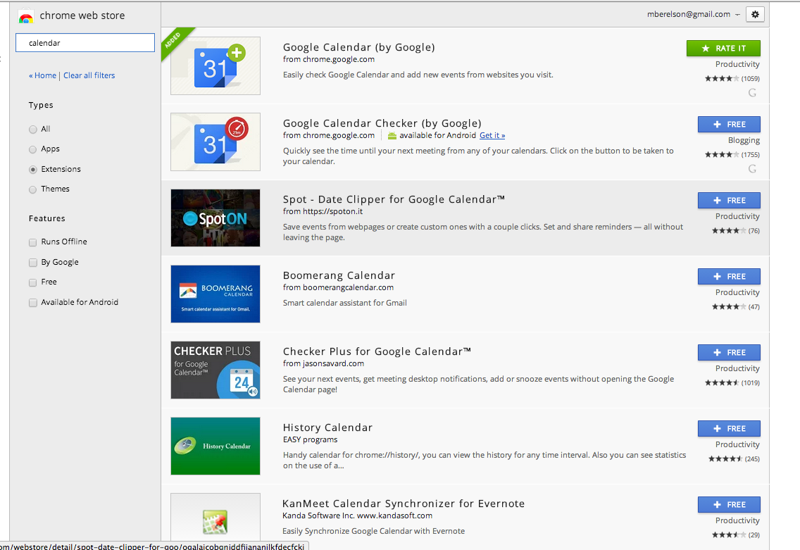
Chrome Extensions
There are many extensions available to customize your calendar.

Slide 33
FURTHER RESOURCES:
Recommended Labs for gMail and Calendar
How To Sync Google Calendar With Every Other Platform
By Matt Smith
Lesson Plans in Google Calendar, or "Organization is the First Step to Faking It" Sheri.com
Interactive Tour of Google Calendar
Using Google Calendar for Lesson Planning
The Electric Educator
Google Calendar as Lesson Plans and Embedded In Blog
iPaddiction
Google Calendar Essentials Video How-to
The Google Calendar Help Site
Google Apps for Education Training

